Slide 1



#semanticClimate’s Progress: From being part of hackathons to running them!
www.semanticClimate.org
Shweata N. Hegde (Volunteer Developer at #semanticClimate; science communicator)
This Photo by Unknown Author is licensed under CC BY

Slide 2
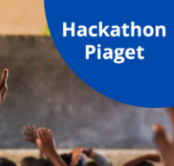



In next 10 min.
#semanticClimate: What we do?
How hackathon Piaget changed the way we work
Progress since last year: Climate Knowledge Explorer
Learnings and takeaways from hackathons we’ve run
What next

Slide 3

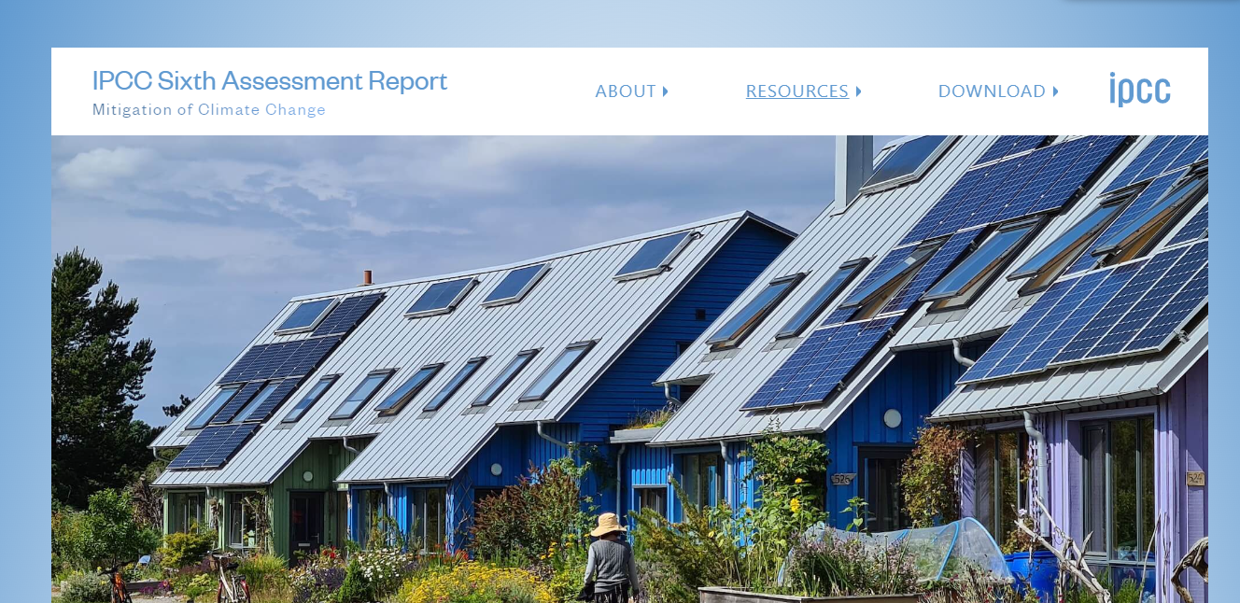
Climate crisis needs urgent action.
Information to save the world is locked in PDF reports
7 Reports, 15000 pages, 1200 terms;
technical
not editable
What we do?
IPCC Reports
Citizens are desperate to know this!

Slide 4
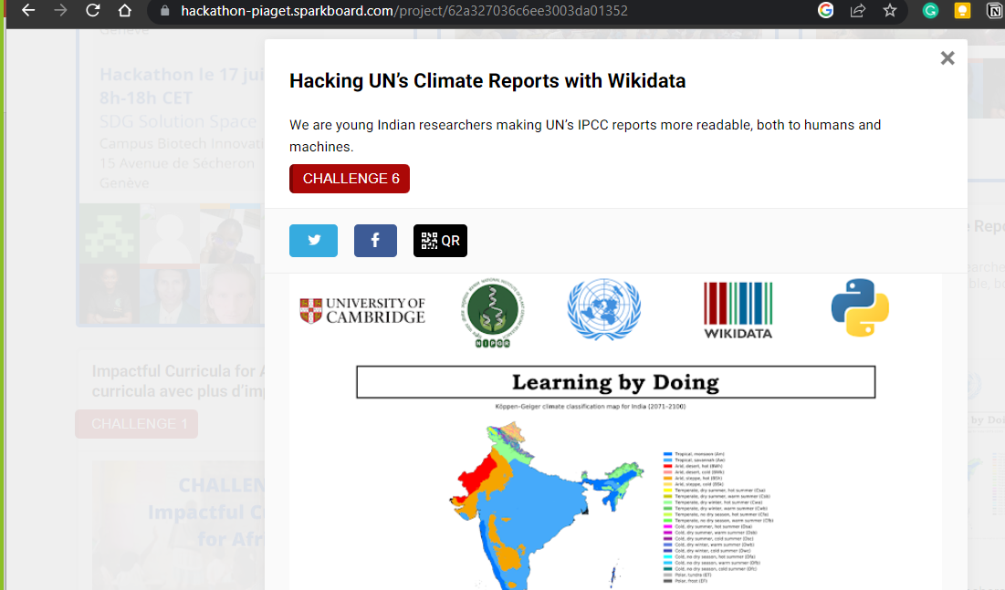
Hackathon Piaget 2022

Slide 5


Last year’s pipeline to make climate facts accessible
Climate-related terms dictionary
pyami
docanalysis
…despite mitigation efforts 8 including those in near-universal nationally determined contributions (NDCs)…
< >
HTML
From PDF to climate facts
What we do?
IPCC chapters,
IPBES reports,
…
Abbreviation dictionary
Hackathon Piaget 2022
docanalysis
Shweata N. Hegde, Ayush Garg, Daniel Mietchen, Peter Murray-Rust

Slide 6
In last year’s (2022) Hackathon Piaget …
Hackathon Piaget 2022

Slide 7
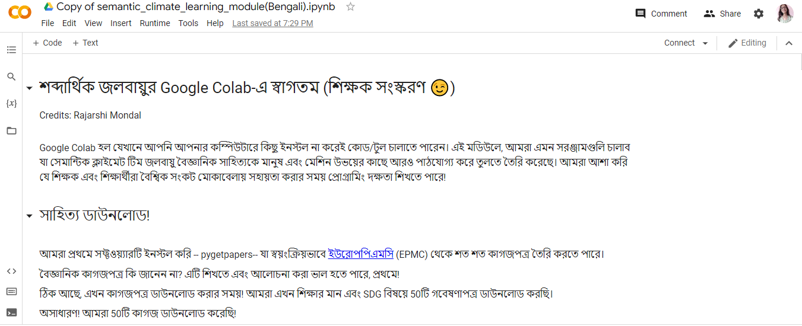
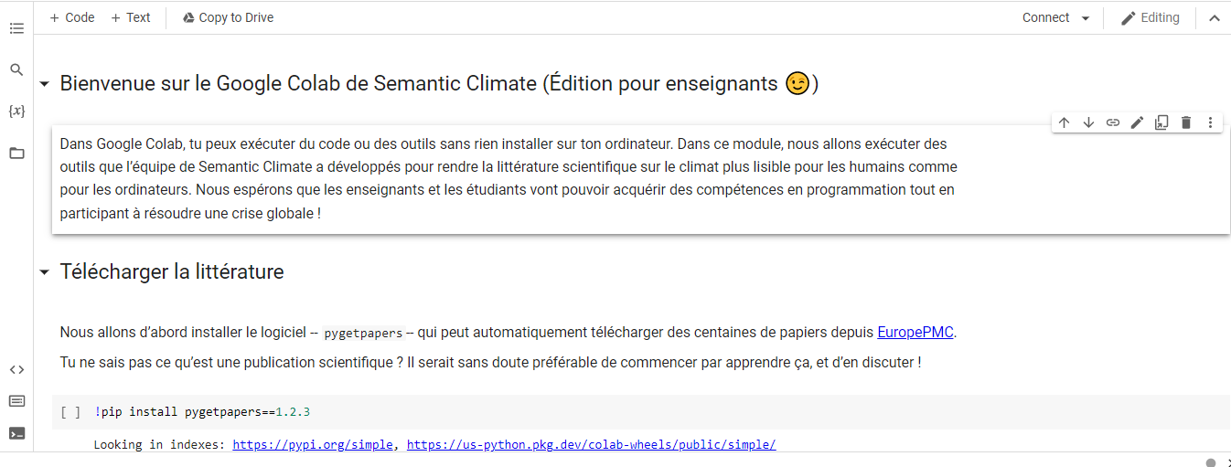
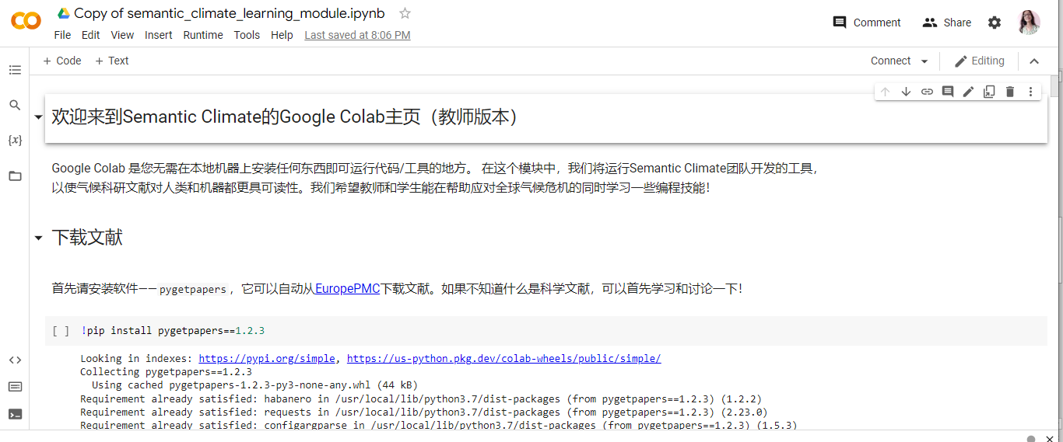
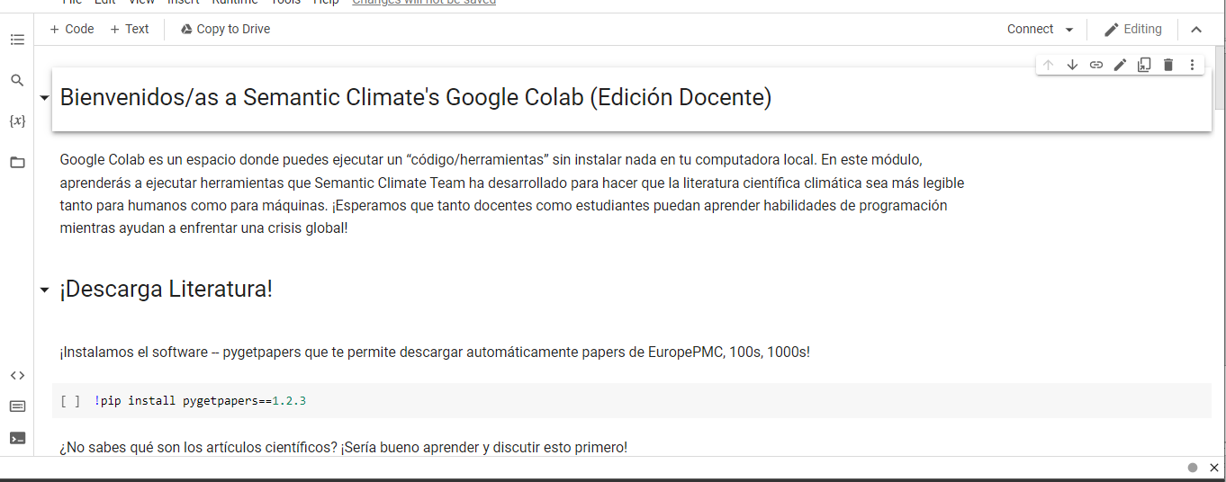
Translated into 6 different languages!
Hindi
Italian
Bengali
French
Mandarin
Spanish
Hackathon Piaget 2022
Notes:
Add more screenshots

Slide 8
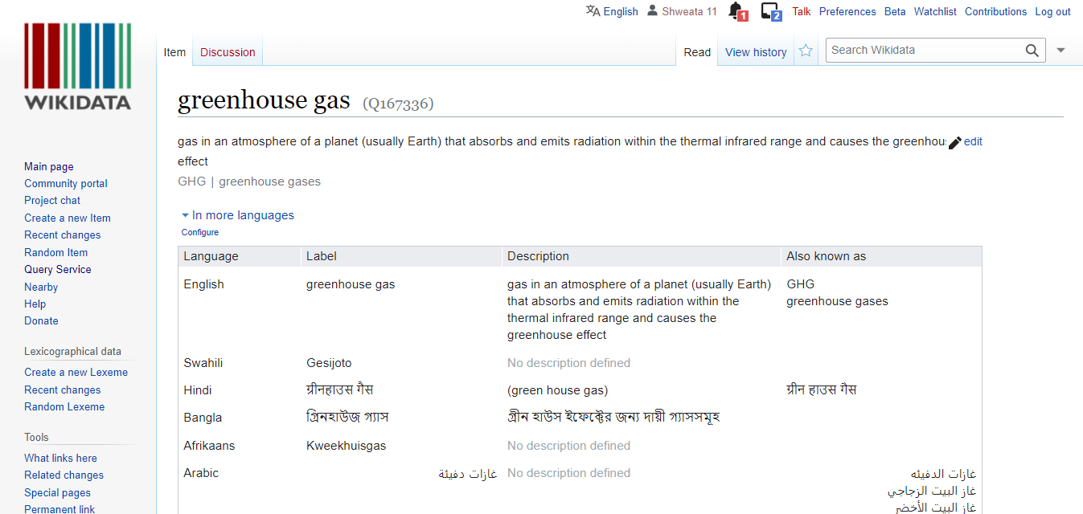
Dictionary
Set of terms with unique Wikidata Identifiers
<entry name="VRE" term="Variable Renewable Energy" wikidataID=“Q7915732”/>
<entry name=“NDC" term=“Nationally Determined Contributions" wikidataID=“Q20051297”/>
<entry name=“GHG" term=“Greenhouse Gas" wikidataID=“Q167336”/>
What we do?
In different languages!
Hackathon Piaget 2022

Slide 9
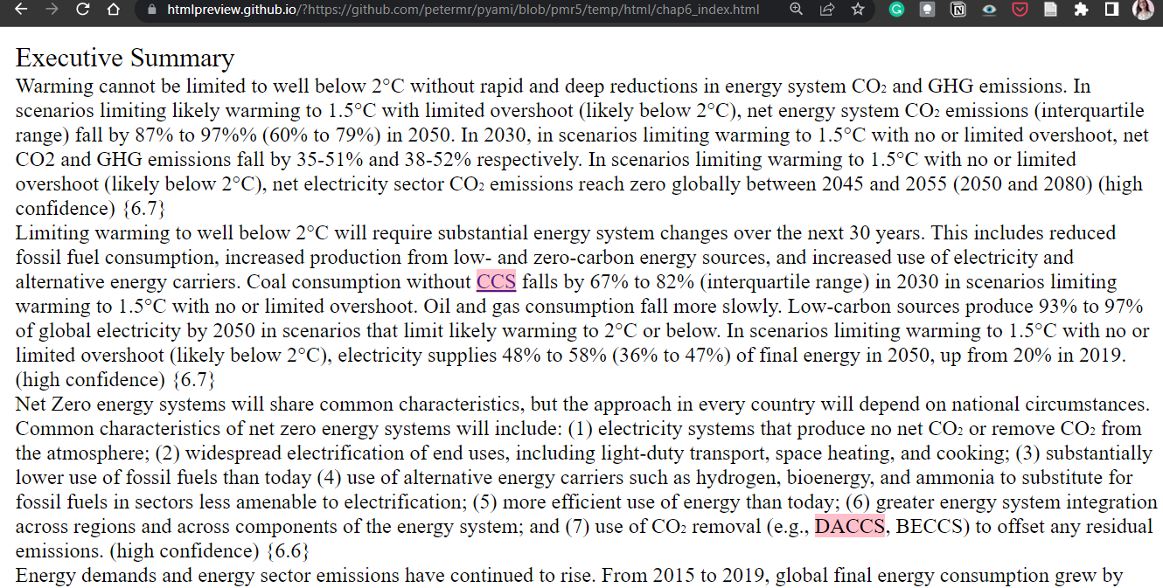
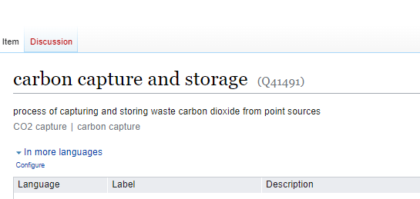
What’s CCS? Look up Wikidata!
What we do?
Hackathon Piaget 2022

Slide 10
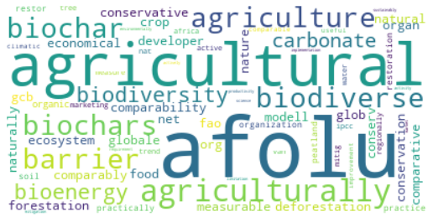
Common terms in chapter?
< >
HTML
Keyword extraction
What we do?
Hackathon Piaget 2022
Work by Ananya Singha, Karthikeyan V.

Slide 11

Translated into 6 different languages!
Hindi
Italian
Bengali
French
6 non-programmers ran our code!
#Learning by Doing
Mandarin
Spanish
Hackathon Piaget 2022
Notes:
Add more screenshots

Slide 12
The success inspired us to…
Run more events and have more volunteers

Slide 13

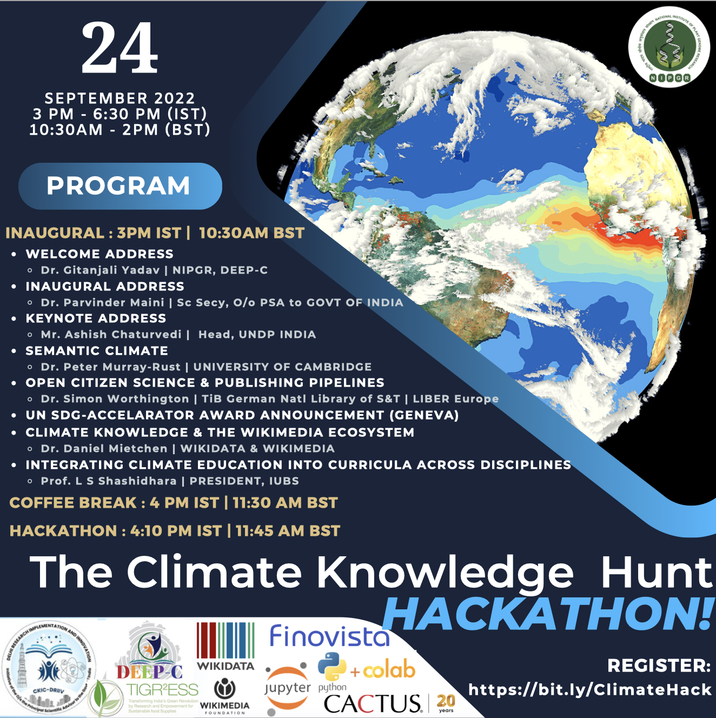
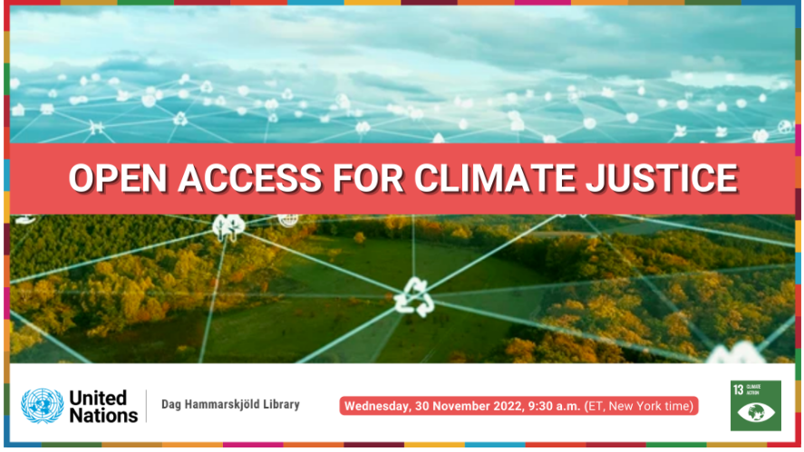
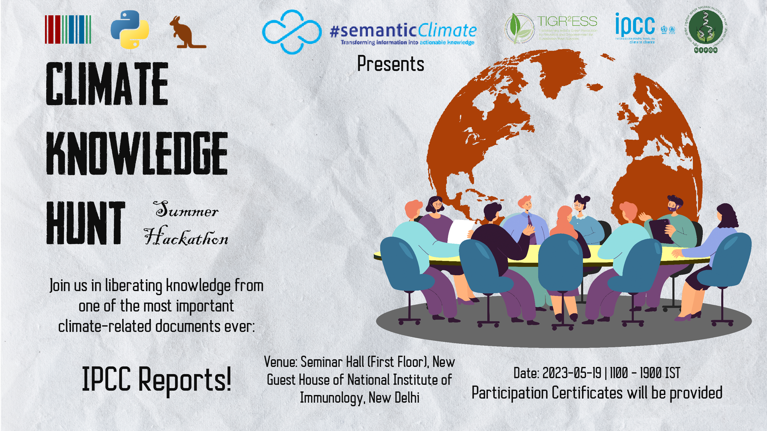
Post Hackathon Piaget
Online Hackathon In Delhi (September 2022)
UN Library (November 2022)
Hybrid Hackathon In Delhi (May 2023)

Slide 14
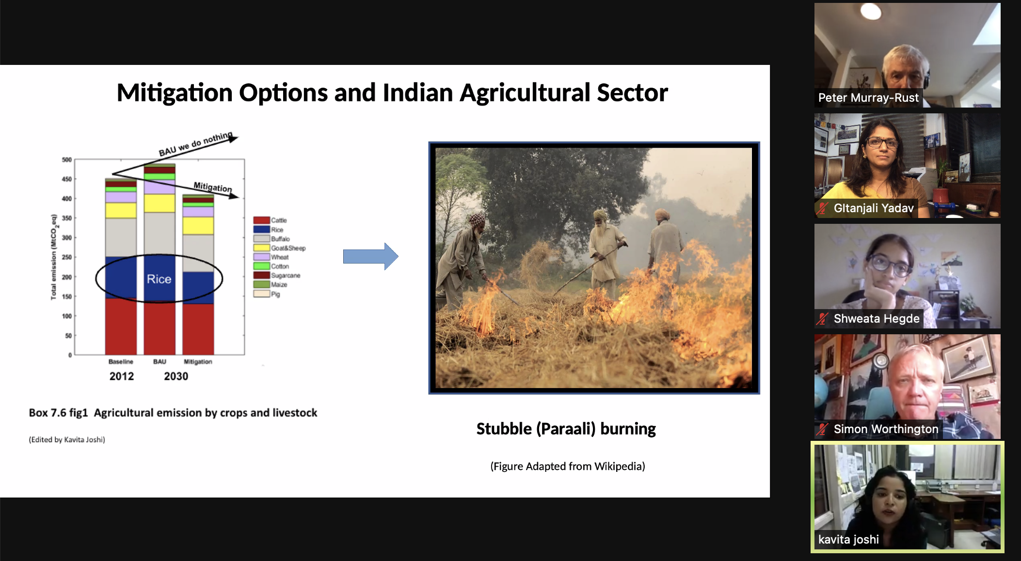
Online Hackathon In Delhi (September 2022)
50 + attendees
Women in Climate; Principal Scientific Advisor, India; UNDP

Slide 15
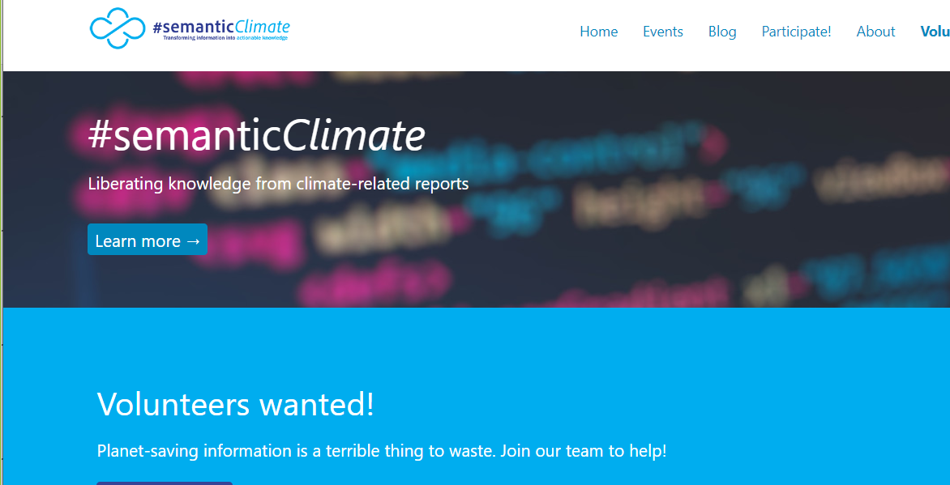
Website: www.semanticClimate.org
Axel Durkop, Hamburg

Slide 16
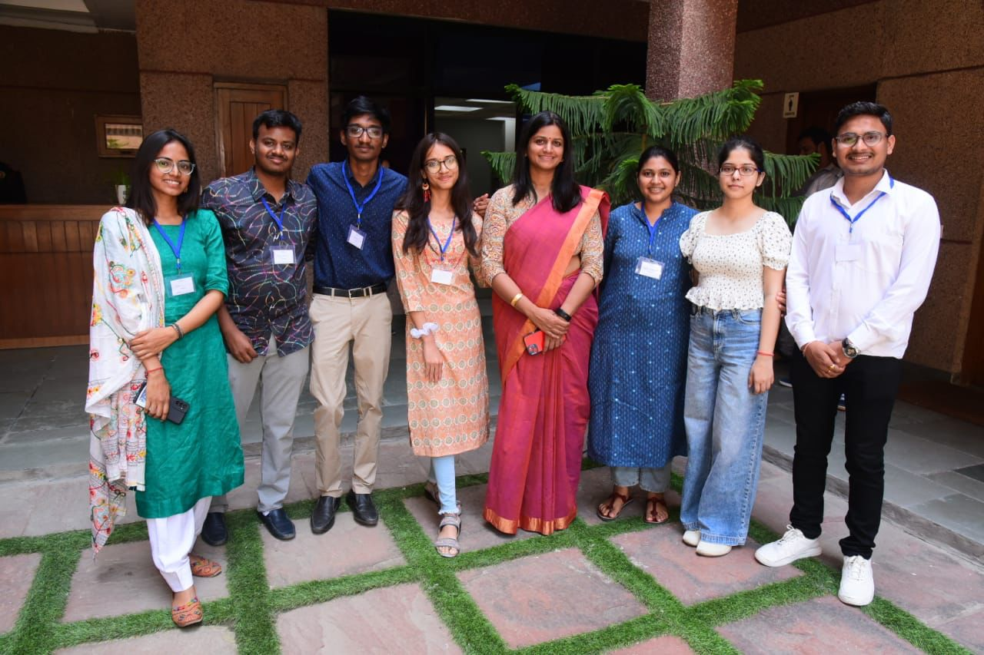
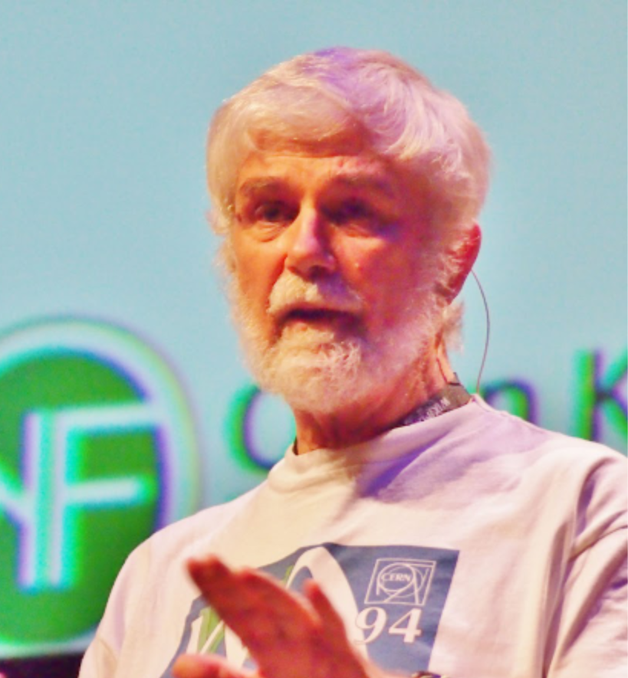
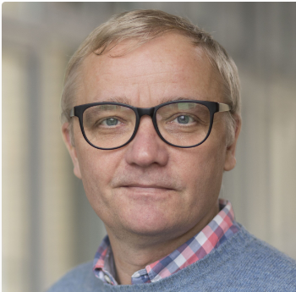
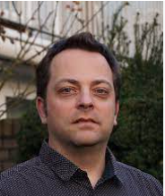
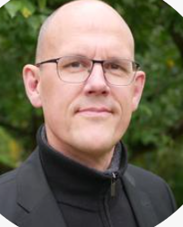
Volunteers and Hackathons
Global Volunteers
Peter Murray-Rust
Simon Worthington
Axel Durkop
Egon Willighagen
Left to Right: Priti Chahal, Sunag Parasu, Karthikeyan V., Shweata N. Hegde, Gitanjali Yadav, Gayathri, Ananya Singha, Dhananjay Sharma
More interns in the past…
KARYA, INYAS

Slide 17
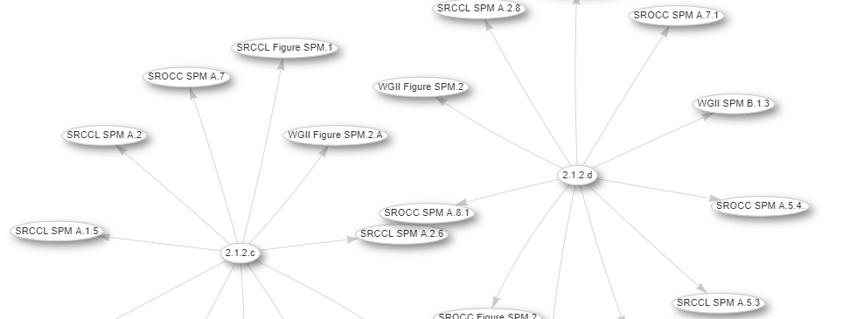
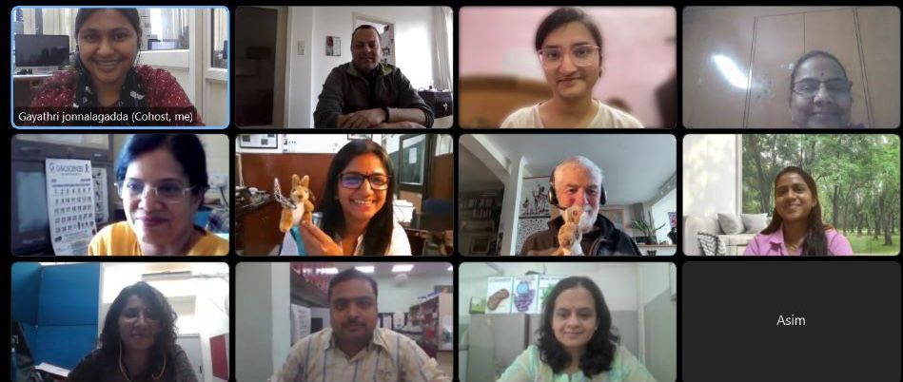


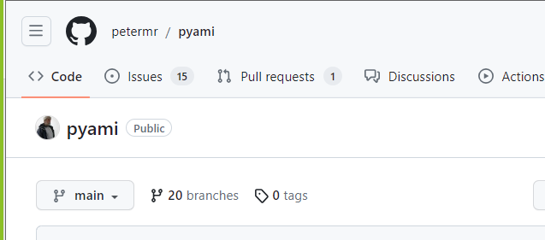
Climate Knowledge Explorer for Everyone!
Join us in making climate facts accessible!
What we do?
Content
Tools
Community Processes
This Photo by Unknown Author is licensed under CC BY

Slide 18
Last year’s pipeline to make climate facts accessible
Climate-related terms dictionary
pyami
docanalysis
…despite mitigation efforts 8 including those in near-universal nationally determined contributions (NDCs)…
< >
HTML
PDF to climate facts
What we do?
IPCC chapters,
IPBES reports,
…
Abbreviation dictionary
docanalysis
Shweata N. Hegde, Ayush Garg, Daniel Mietchen, Peter Murray-Rust

Slide 19
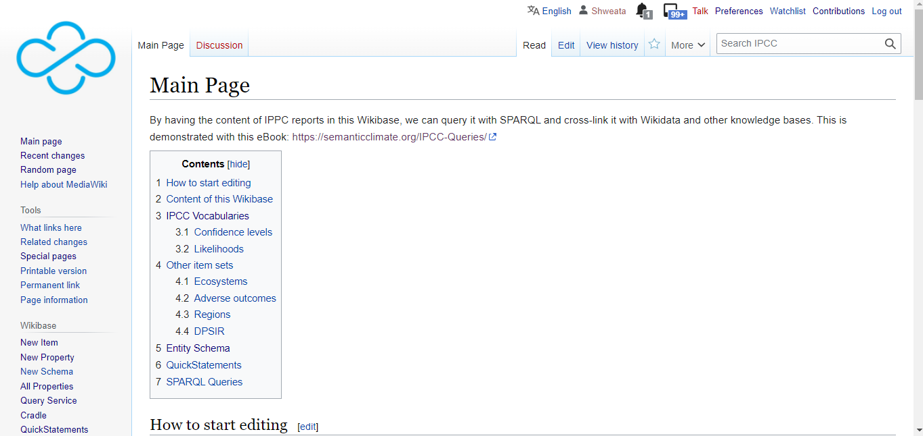
Wikibase: Climate facts accessible to all
PDF to climate facts
Egon and Lars Willighagen

Slide 20
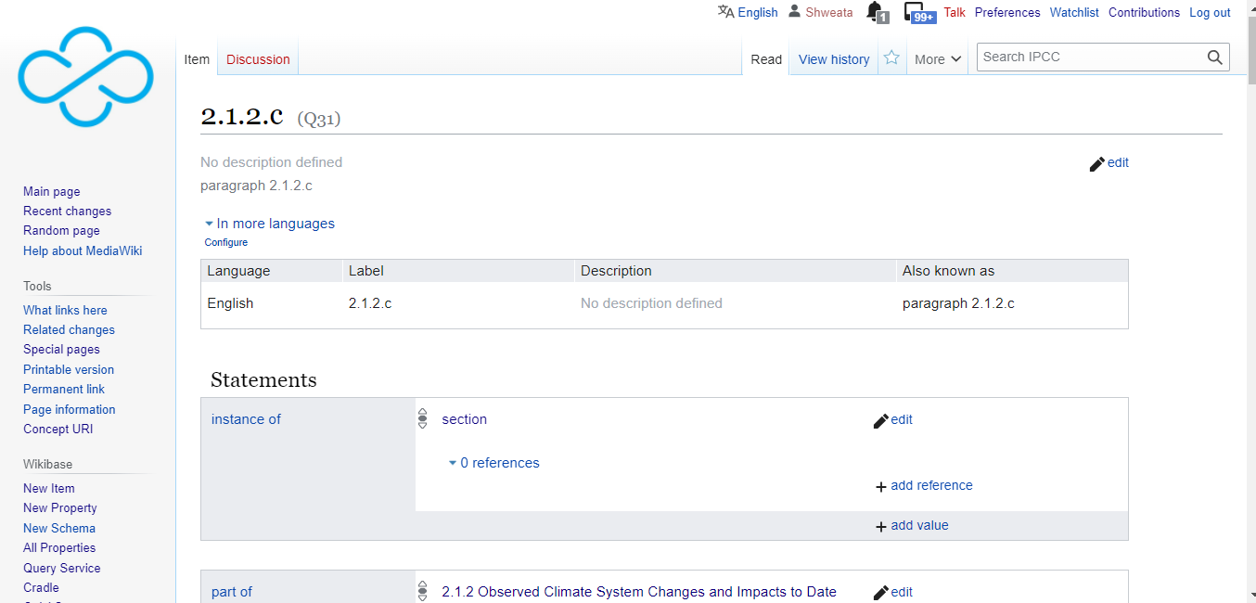
IPCC Knowledge Base

Slide 21
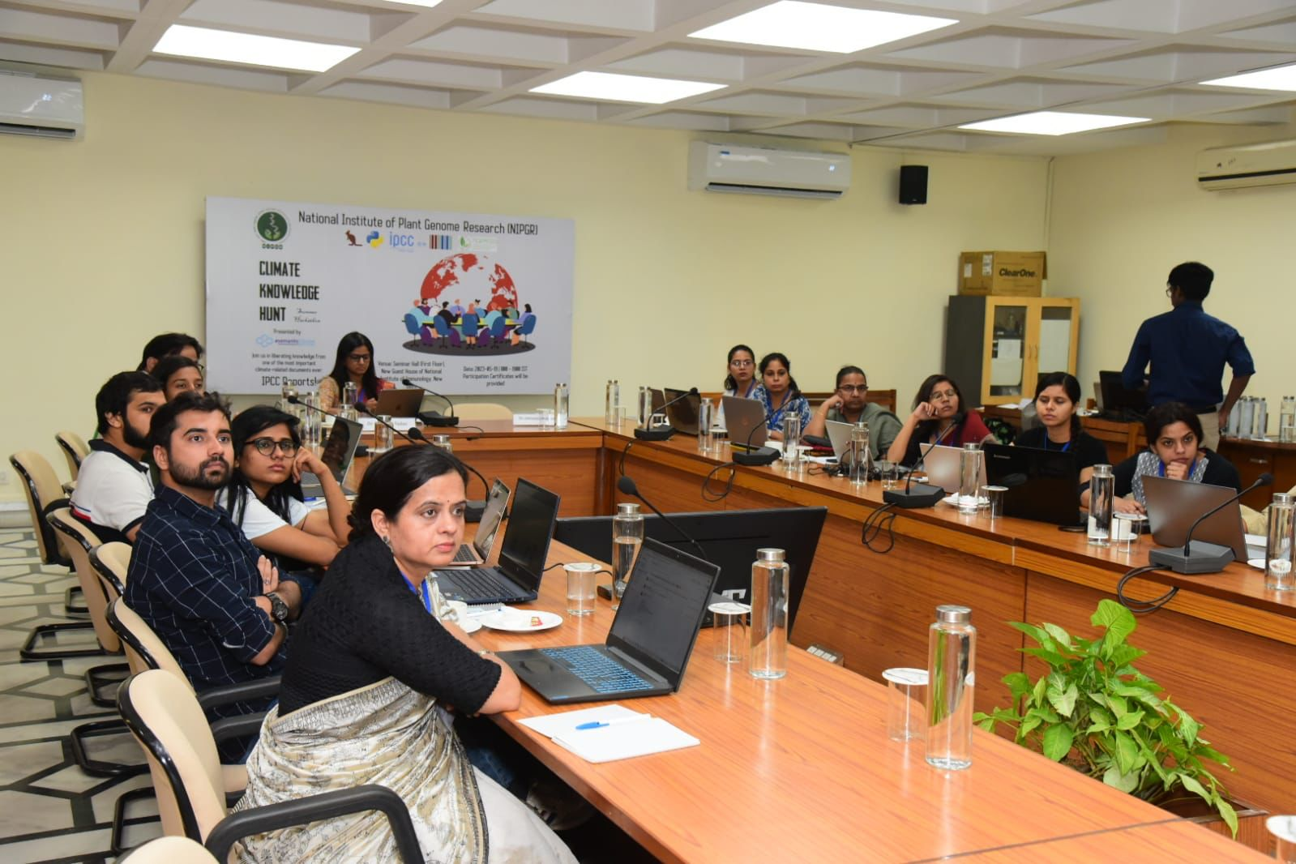
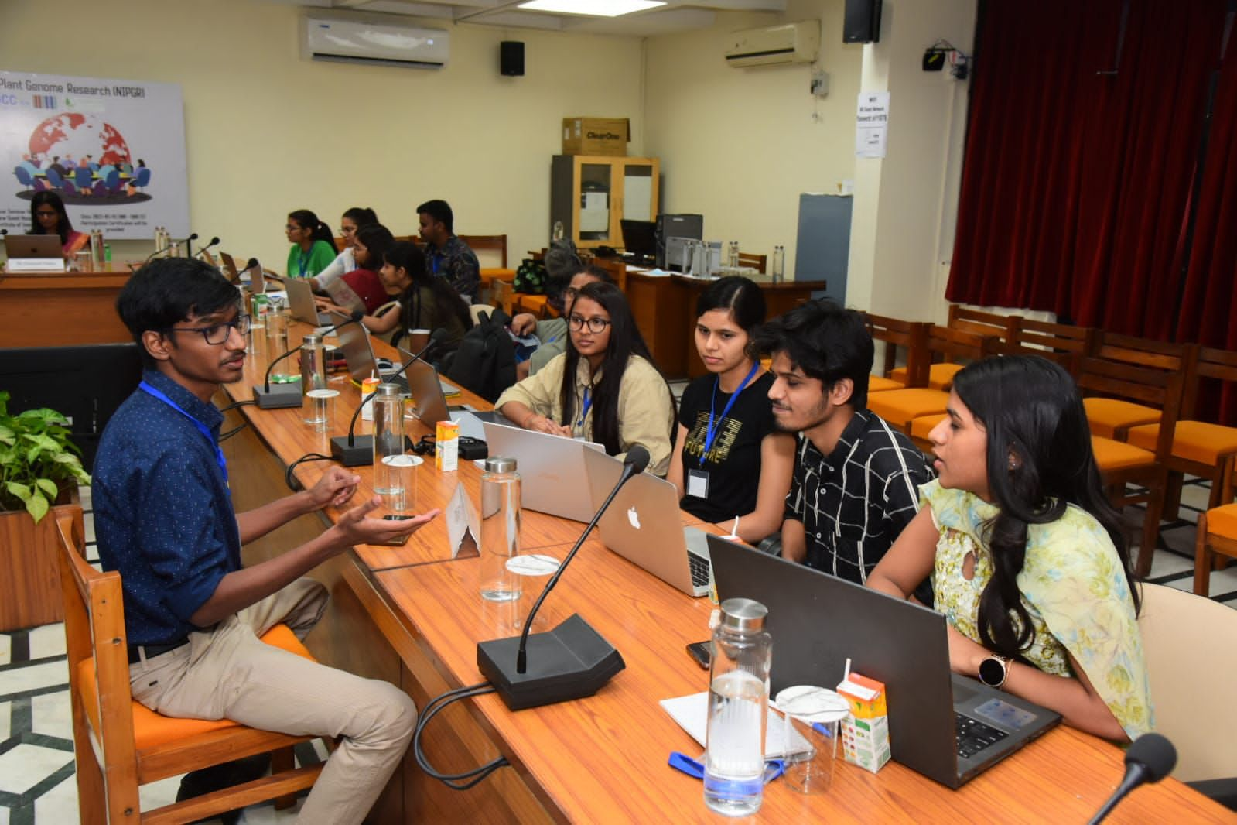
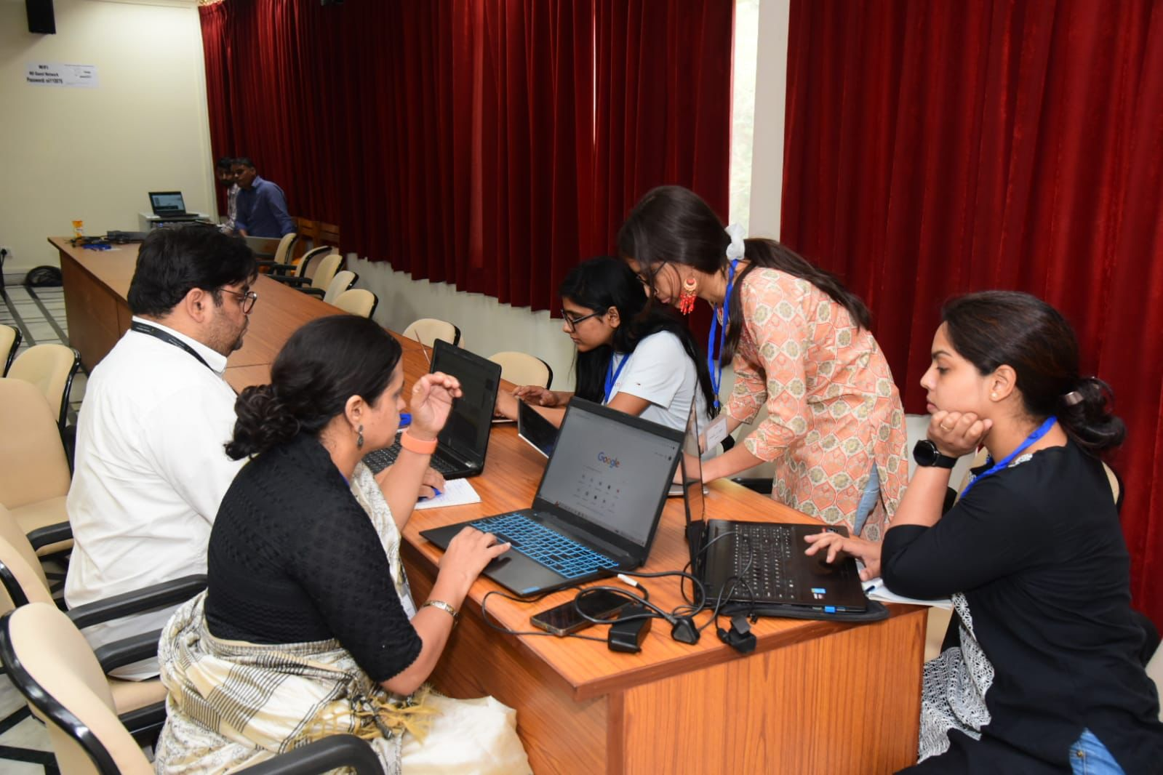
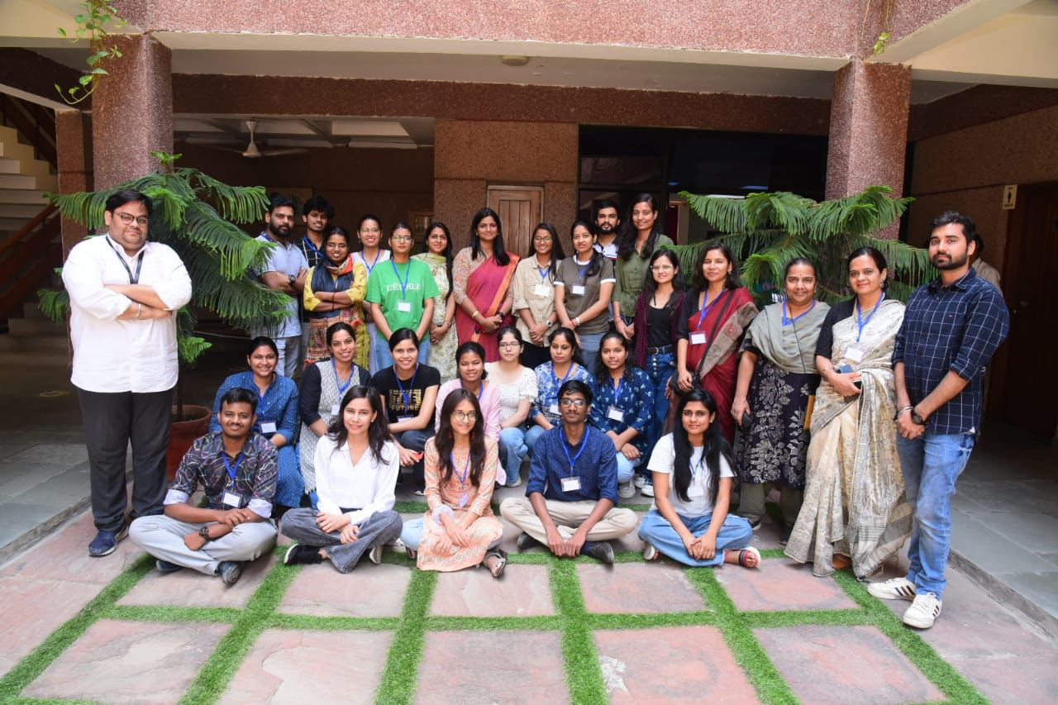
Climate Knowledge Hunt May 2023, NIPGR Delhi (#Learning By Doing) 25 attendees
Notes:
More group pictures (young people!)

Slide 22
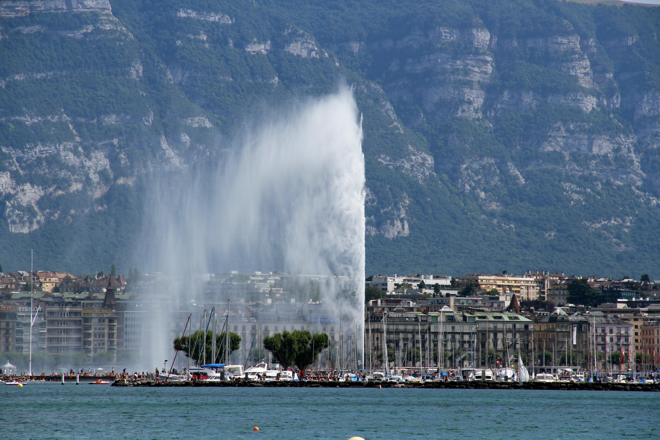
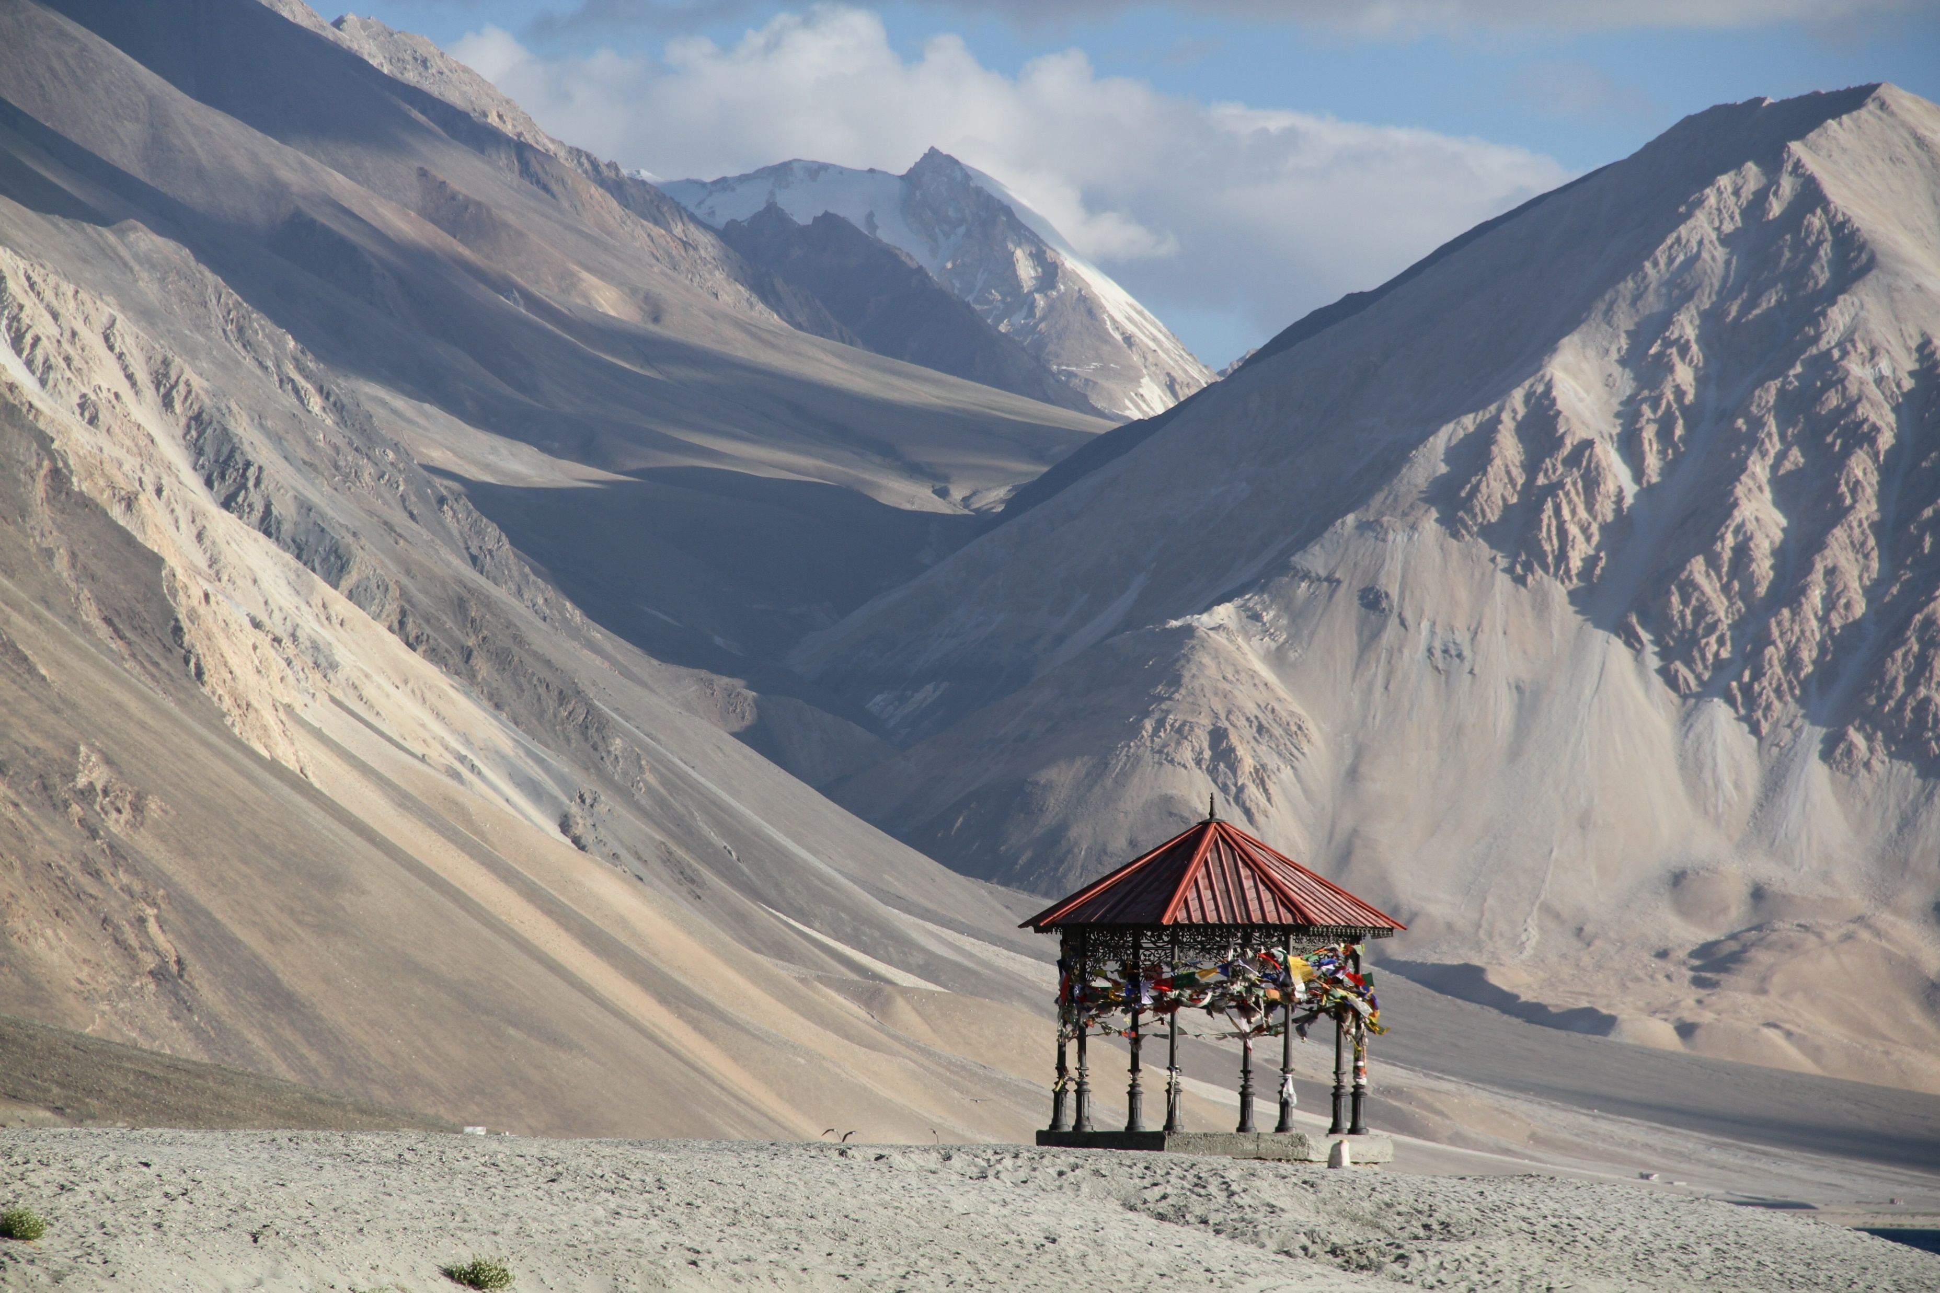
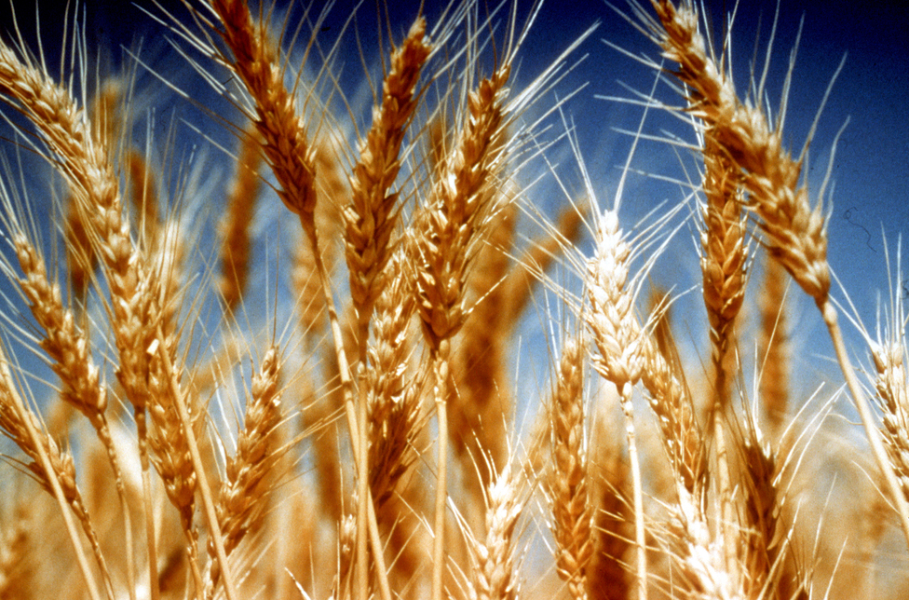
What next? Hackathons produce volunteers
Climate Knowledge for Everyone (IPCC Chapters support volunteers to become climate experts)
Cities
(IPCC/WG3/Chapter 08)
Chapter Champion: Priti Chahal
High mountains
(IPCC/SROCC/ Chapter 02)
Chapter Champion: Shiwani Yadav
Food security
(IPCC/SRCCL/Chapter 05)
Chapter Champion: Yasin
By Lional Rajappa - Own work, CC BY-SA 3.0, https://commons.wikimedia.org/w/index.php?curid=16352290
This Photo by Unknown Author is licensed under CC BY

Slide 23
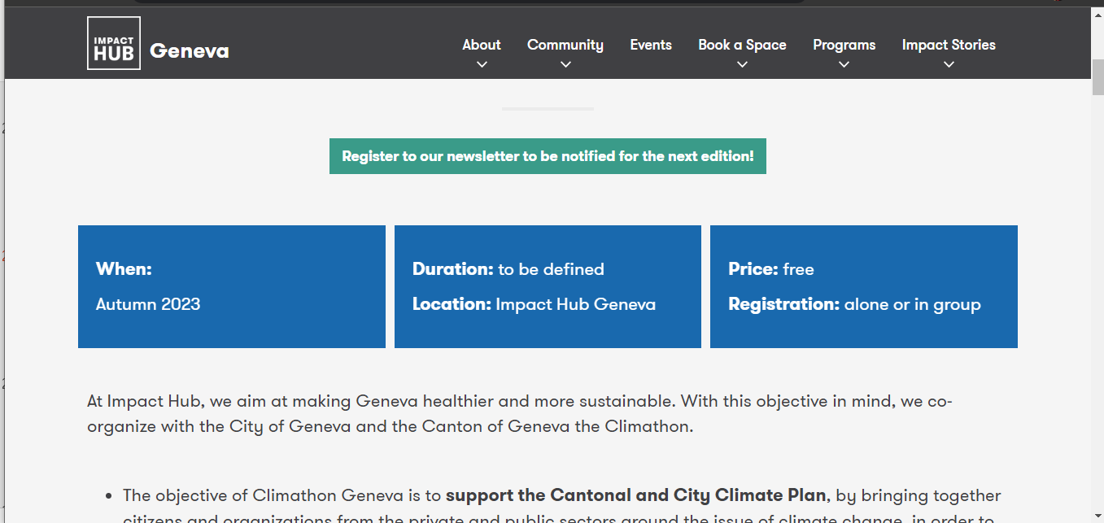
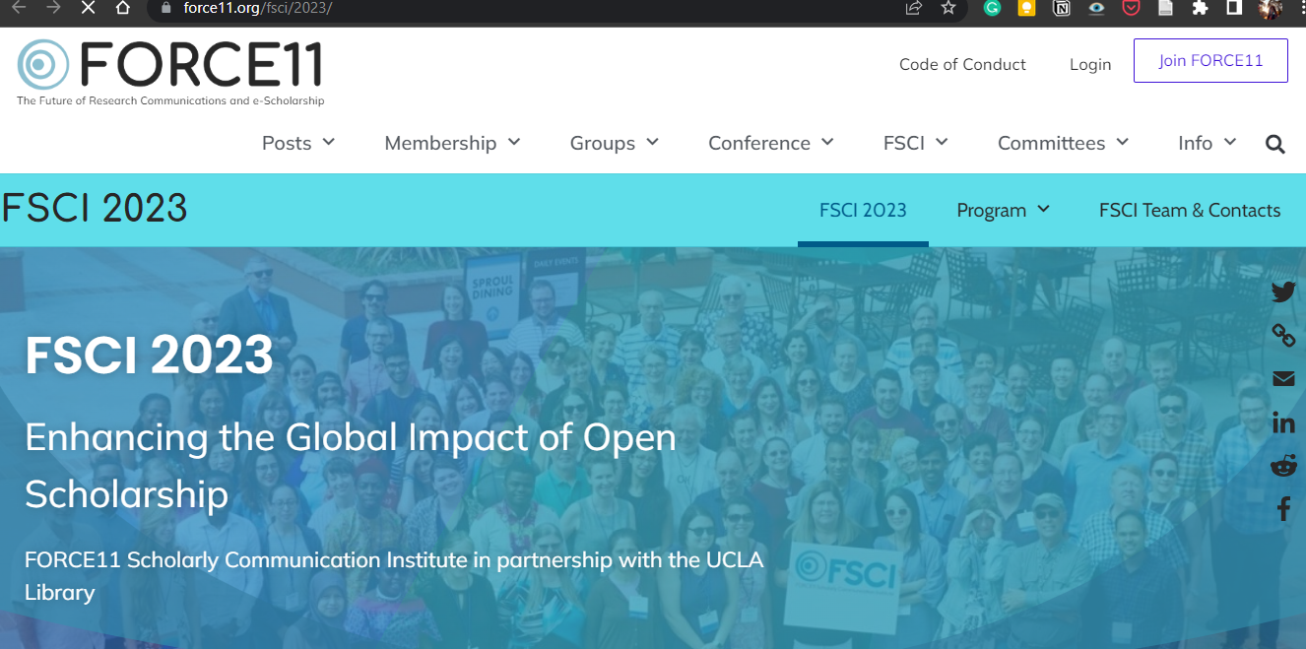
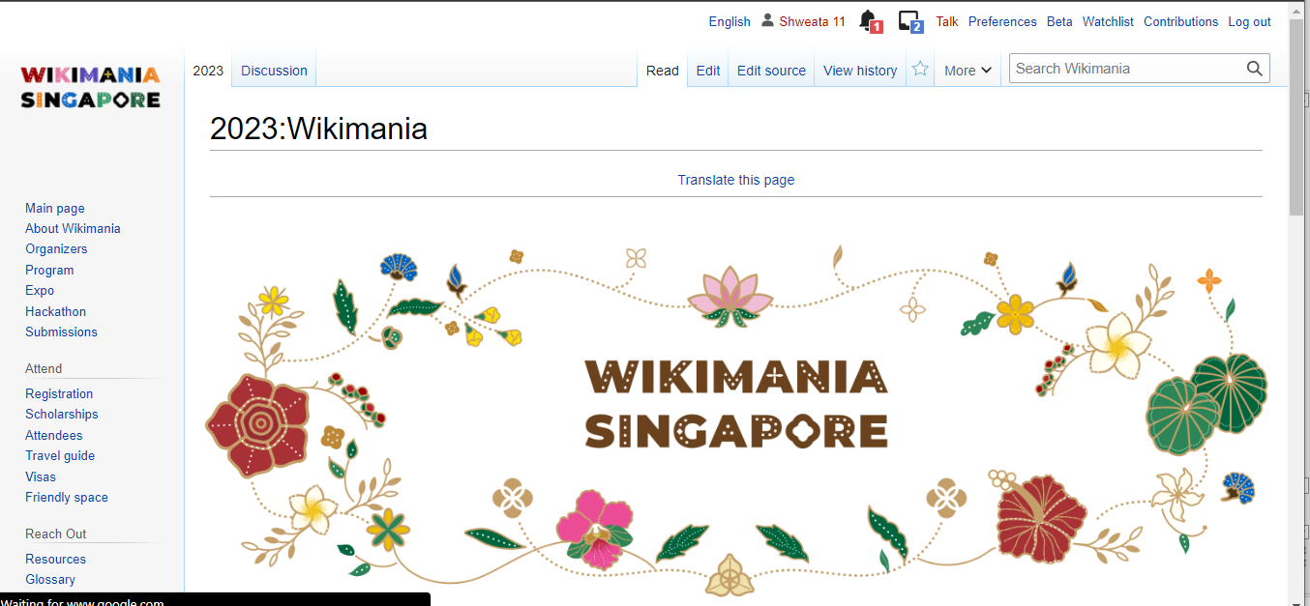
What Next? Advancing Tech and Building Community!
FSCI Hack, July 2023
Online hackathon for librarians and academicians
Wikimania, Aug 2023
Presenting our project to Wikimedia
Climathon, Oct. 2023

Slide 24
Useful links
#semanticClimate: www.semanticClimate.org
semanticClimate GitHub Repo: https://github.com/petermr/semanticClimate
py4ami: https://github.com/petermr/pyami
docanalysis: https://github.com/petermr/docanalysis
#sC Twitter: https://twitter.com/semanticClimate
This Photo by Unknown Author is licensed under CC BY

Slide 25


Thank you!
Mentors and Global Volunteers
Current Team and Past Interns
Peter Murray-Rust
Simon Worthington
Egon Willighagen
…
Left to Right: Priti Chahal, Sunag Parasu, Karthikeyan V., Shweata N. Hegde, Gitanjali Yadav, Gayathri, Ananya Singha, Dhananjay Sharma
Axel Durkop

Slide 26
Climate Knowledge Explorer for Everyone!
Join us in making climate facts accessible!
What we do?
Content
Tools
Community Processes
This Photo by Unknown Author is licensed under CC BY

